Slide 1


December 6, 2024
Public Library Group 1
RESEARCH PROPOSAL PRESENTATION
Increasing Social Workers in Public Libraries: How Social Workers in Public Libraries Provide Supportive Resources for Patrons in Crisis and Public Library Staff

Slide 2

Public Library Group 1
We are excited to introduce our research proposal for Public Library Group 1, which aims to address the increasing need for Social Workers in Public Libraries and how the role provides supportive resources for patrons in crisis.
HELLO!

Slide 3

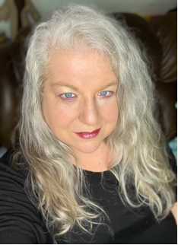
Public Library Group 1
Meet the A-Team
Angi Carr
A. B.
A. K.
A. B.
Library Associate
Monroe County Public Library
Library Assistant
Pikes Peak Library District
Librarian
Librarian
Special Collections & Records
Museum of Fine Arts

Slide 4

Public Library Group 1
AGENDA OVERVIEW
01
Background of the Study
02
Statement of Need
03
Significance of Study
04
Research Goals
05
Methodology
06
Proposed Survey Timeline
07
Budget
08
Analysis

Slide 5


County library management has noted a significant increase in reports from librarians and staff regarding patron demands for social services from these impacted groups.
Our staff needs training on how to identify and deal with patrons in crisis. We also need more qualified staff to deal with this ongoing crisis in our community.
Our libraries need community partnerships with other agencies, like social workers, to assist our most vulnerable patrons and community members.
No matter the struggle, these are still human beings that need dignity and respect. We need to not just be a venue of information, but a place to give help.
Public Library Group 1
BACKGROUND OF THE STUDY

Slide 6
Public Library Group 1
This research proposal will underscore the crucial role of a social worker in the public library.
Patrons in need of and requesting resources that a social worker would be able to provide, will benefit greatly, as will the library itself.
SIGNIFICANCE OF STUDY

Slide 7

Public Library Group 1
RESEARCH GOALS
The overall goal of this study is to explore how public libraries play an active and meaningful role in supporting patrons in crisis by integrating social work services
01
02
03
HIRING & SELECTION PROCESS
IDENTIFYING NEEDS
STAFF TRAINING
What social and informational needs can public librarians help identify when supporting the integration of social services in public libraries, as opposed to merely serving as a venue?
What types of staff training and patron programming are necessary for librarians and in-house social workers to effectively meet these needs?
How do public libraries approach the hiring and selection of social workers who will collaborate effectively with librarians?

Slide 8


Public Library Group 1
Qualitative Methods
Qualitative research methods involve collecting and analyzing non-numerical data to explore the underlying motivations, perceptions, and behaviors of individuals. In our research proposal, qualitative methods will be utilized to gain in-depth insights into consumer preferences, attitudes, and experiences related to the new product.
METHODOLOGY
Quantitative Methods
Quantitative research methods involve collecting and analyzing numerical data to quantify relationships, trends, and patterns. In our research proposal, quantitative methods will be employed to measure the prevalence, frequency, and magnitude of certain phenomena related to the new product.

Slide 9





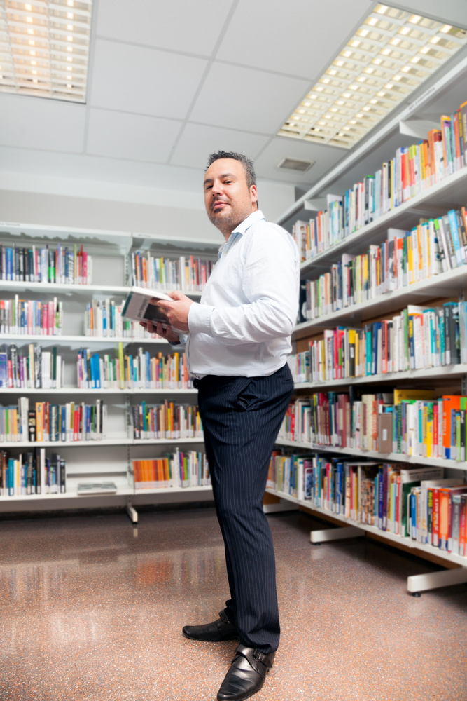

Public Library Group 1
QUALITATIVE DATA
We collected qualitative data through open-ended survey questions that addressed the social and informational needs that public librarians identified in support of the addition of social workers in their libraries.
The survey questions librarians on the types of staff training and patron programming that are necessary for librarians and in-house social workers to effectively meet these needs.
Lastly, the survey asks our sample how their public libraries approach the hiring and selection of social workers who will collaborate effectively with librarians to serve their communities.
Hillsborough County
Polk County
Pinellas County
YA Services Librarian
Reference Librarian
Technical Services
Manatee County
Pinellas County
Pasco County
Adult Services Librarian
Branch Manager
Youth Services Librarian

Slide 10

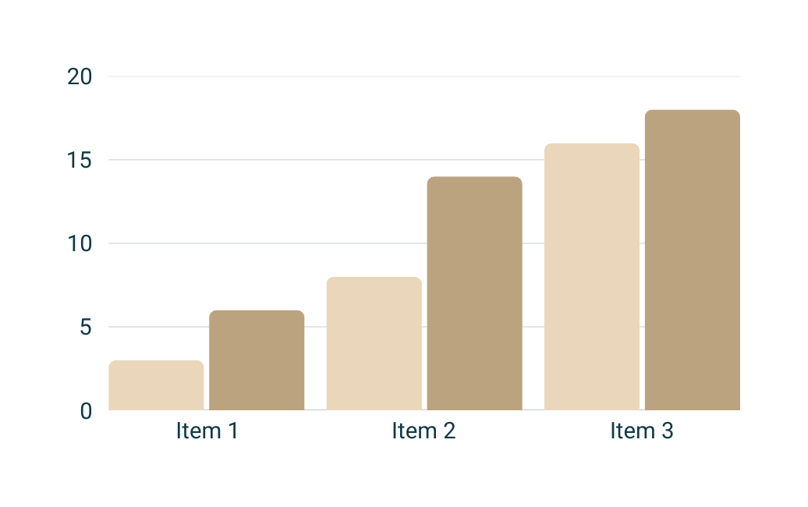



Public Library Group 1
QUANTITATIVE DATA
We will collect quantitative data, such as demographics (age, gender, years of experience, job title), that will be graphed and tabulated for analysis.

Slide 11
Public Library Group 1
PROPOSED SURVEY TIMELINE
01
03
Week 2
Week 6
We will send out the actual surveys to complete online. Each survey should send back a standardized thank you email once completed.
We will stop accepting surveys and begin analyzing the data.
02
04
Week 1
Week 5
We will begin by sending an introductory email to all librarians in our sample population, providing advance notice of our study and its goals. We will ask them to keep an eye out for our survey, and kindly request that they complete and return it
we will send a follow-up reminder email to the nonrespondents asking them to please complete the online survey

Slide 12
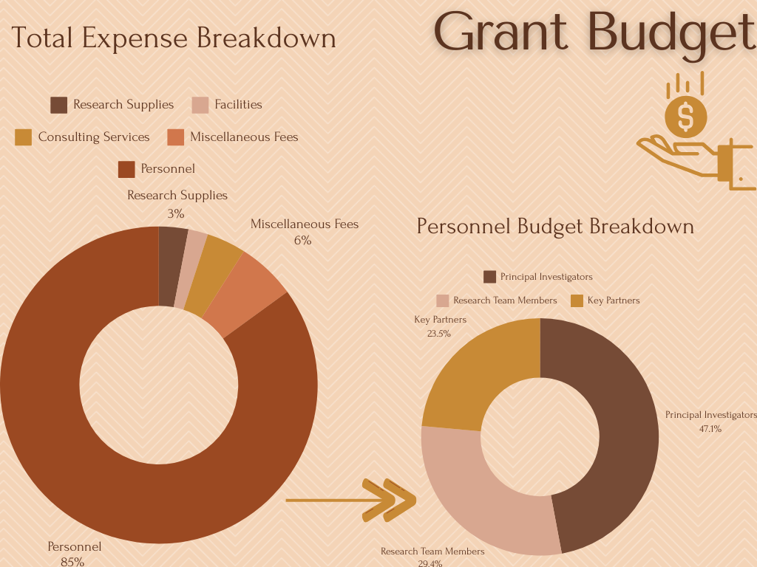
Public Library Group 1

Slide 13
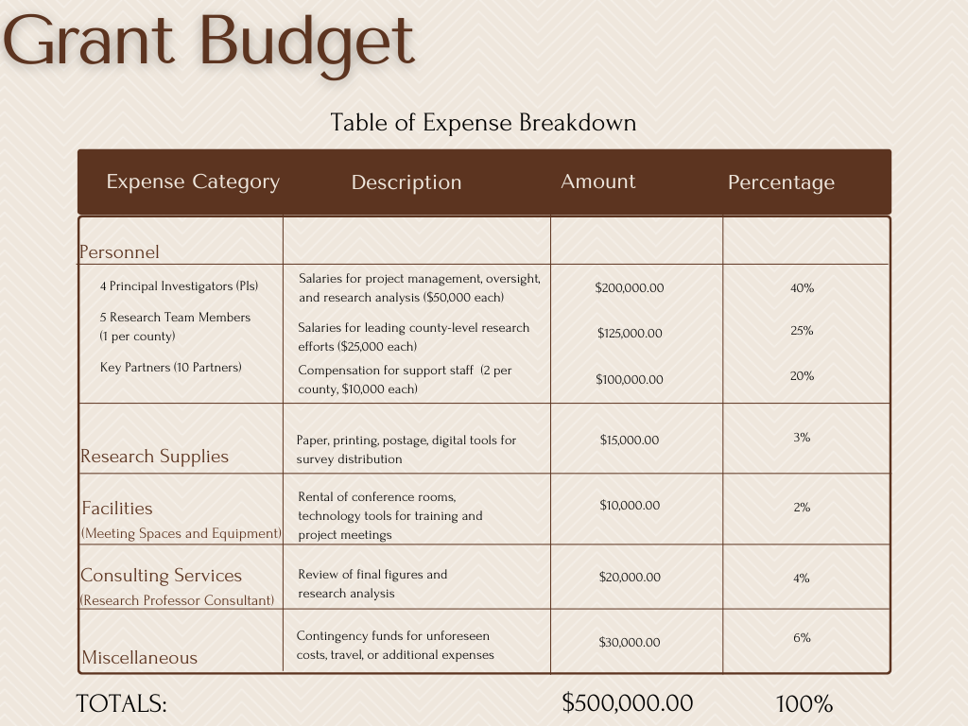

Slide 14
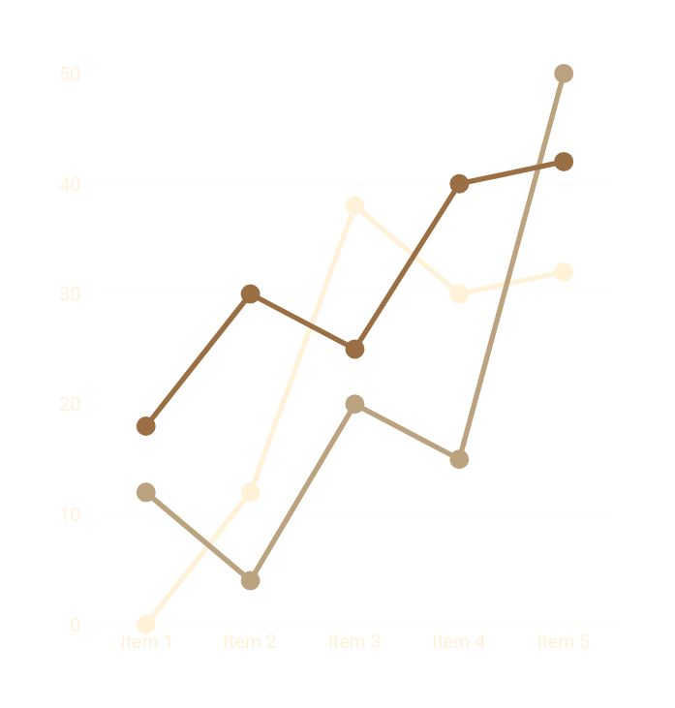



Public Library Group 1
ANALYSIS
We will evaluate how the responses align or diverge from our research goals and how this study could inform future practices in other counties and states.
By focusing on Hillsborough County and gathering critical information from neighboring counties (Manatee, Polk, Pinellas, and Pasco counties), we anticipate that our data will offer a comprehensive understanding of whether the challenges faced in Hillsborough are unique or shared by nearby regions.
This analysis will help demonstrate how the integration of social workers, in conjunction with existing public library resources, can effectively address the needs of disadvantaged patrons.

Slide 15

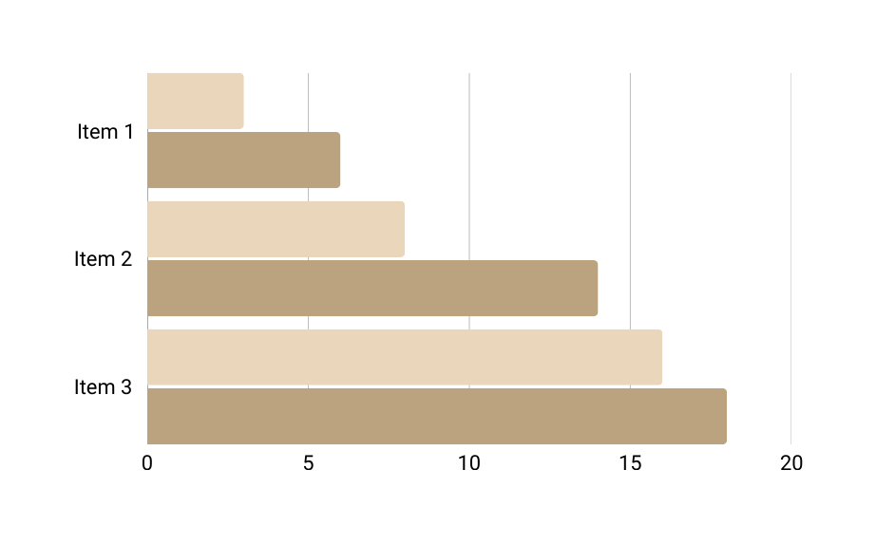
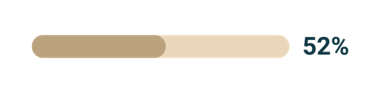
Public Library Group 1
ANALYSIS
Our employed research method will ensure we gather both qualitative and quantitative data to support our goal and assertions as well as draw support for the funding and grants needed to hire social workers in these public libraries.
Findings from our survey questionnaire, coupled with the evidence found in our literature reviews, will show that implementing social workers in public libraries can decrease the number of disadvantaged patrons and help current library staff provide these patrons with the information and help they need to better their lives within the Hillsborough community
Item 1
Item 2
Item 3

Slide 16
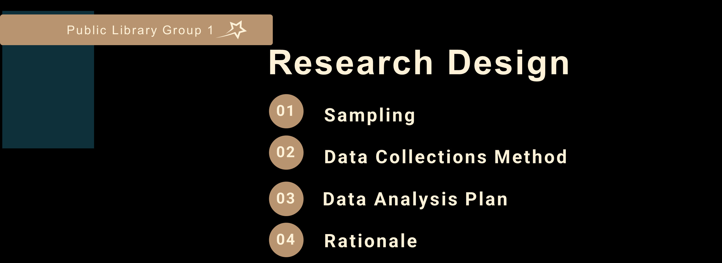
Public Library Group 1

Slide 17


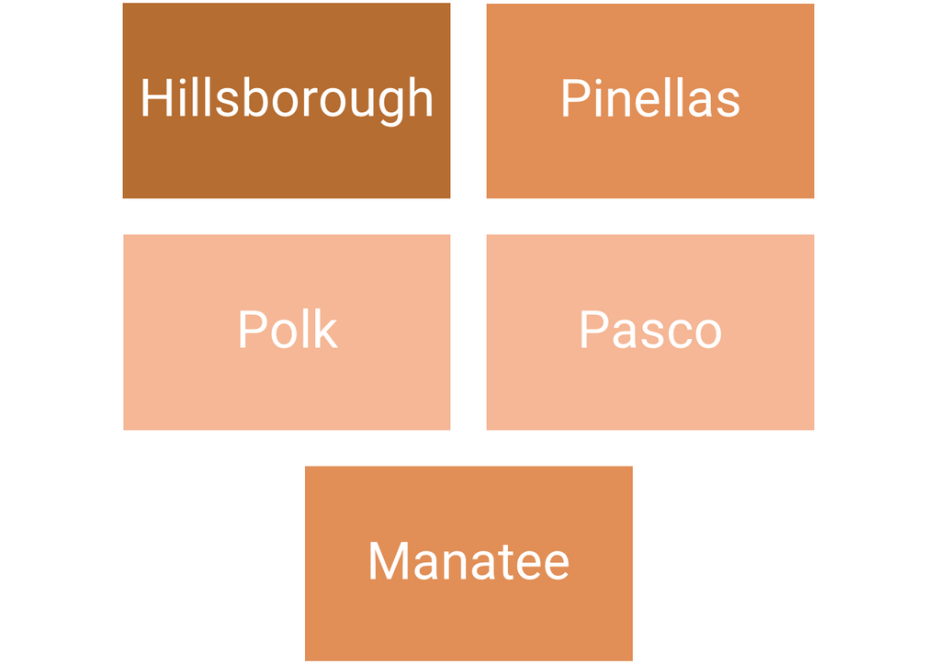
Public Library Group 1
This study analyzes the informational and social needs of social workers and librarians in public libraries through qualitative and quantitative data. The sample demographic will include social workers and librarians from local county public libraries to capture extensive information on patron needs, training, and the selection of social workers. Our sampling data will consist of public libraries from Hillsborough County’s 33 branches, Manatee County's 8 branches, Polk County’s 37 branches, Pinellas County’s 14 branches, and Pasco County’s 9 branches. This sampling population will be able to provide feedback on social worker and public librarian partnerships, educational programs and resources for patrons, and any struggles library staff face due to a lack of knowledge or resources.

Slide 18
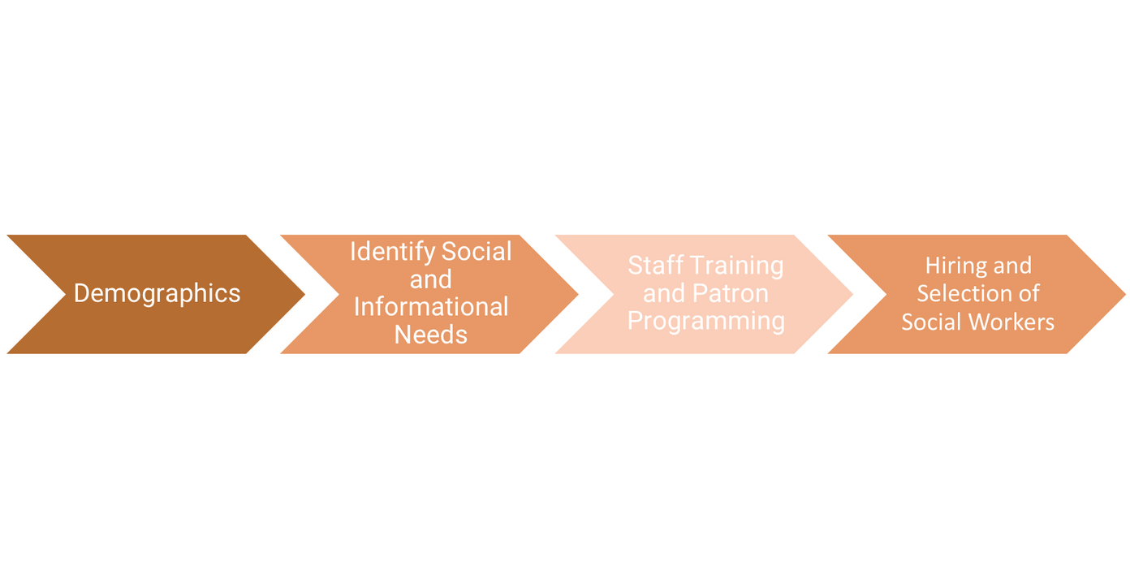
Public Library Group 1
DATA COLLECTIONS METHOD
The data collection method we have chosen is a cross-sectional survey. The survey will consist of quantitative and qualitative data through multiple-choice, yes/no, Likert scale, and open-ended questions. This survey will collect data on demographics, identify social and informational needs, conduct staff training and patron programming, and better understand social workers' hiring and selection process. Our survey will be emailed to our sample population and tested by the staff at Public Library Group 1. In total, we estimate the project will take six weeks to complete.

Slide 19
Public Library Group 1
DATA ANALYSIS PLAN
Our data analysis plan will explore the correlation
between respondents' years of experience and
their views on social work services. It will also
examine relationships and patterns, such as those
between geographic regions and social service needs. Quantitative data will be collected using descriptive statistics from means, medians, and frequency distributions, and Likert scale question responses will be analyzed for trends on the importance of social work services and library-staff integration. Qualitative data will be collected from open-ended questions and will be analyzed for themes and reoccurring concepts. This evaluation and analysis will show us what aligns or diverges from our research goals and will exhibit the necessity of social workers working with existing public library resources, which would greatly affect and address the needs of disadvantaged patrons.

Slide 20

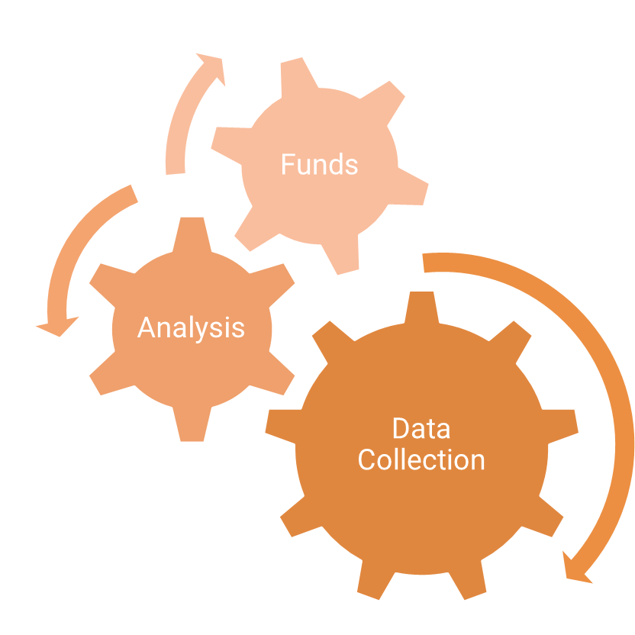
Public Library Group 1
With the increase in social needs, it has become evident that library staff are ill-equipped to deal with and provide services to such disadvantaged patrons. Our goal of this research proposal is to collect sufficient evidence to prove that public library venues play an active and meaningful role in supporting underprivileged patrons when social workers and their services are employed there, and the social worker hiring process and library staff training are integral to ensuring comprehensive support for these patrons. Our research method ensures we collect data supporting our goals by also drawing up funding and grants for hiring social workers.

Slide 21








CONCLUSION
Hillsborough County Public Library staff require essential funding to better serve disadvantaged patrons facing a wide-range of socio-economic challenges. Through grant funding, we believe that offering more social service training, educational programs, and hiring social workers and interns will help achieve our research goal. Based on existing research and our findings, we predict that these efforts will contribute to reducing homelessness, polysubstance abuse, mental illness, and disruptive behavior among library’s patrons.

Slide 22
REFERENCES
Creswell, J.W., & Creswell, J. D. (2022). Research Design: Qualitative, Quantitative, and Mixed Method Approaches. 6th ed. Sage publications.
Florida Council on Homelessness. (2024). 2024 Council on Homelessness Annual Report. Florida Department of Children and Families. https://www.myflfamilies.com/sites/default/files/202407/Council%202024%20Annual%20Homelessness%20Report%20%28002%29.pdf
Lee, S., Bae, J., Sharkey, C. N., Bakare, O. H., Embrey, J., & Ager, M. (2022). Professional Social Work and Public Libraries in the United States: A Scoping Review. Social Work (New York), 67(3), 249–265. https://doi.org/10.1093/sw/swac025Links to an external site.
Lydia P. Ogden & Rachel D. Williams. (2022). Supporting Patrons in Crisis through a Social Work-Public Library Collaboration, Journal of Library Administration, 62:5, 656-672, https://doi.org/10.1080/01930826.2022.208344Links to an external site.
Oudshoorn, A., Van Berkum, A., Burkell, J., Berman, H., Carswell, J., & Van Loon, C. (2022). Supporting Mental Health in a Public Library Context: A Mixed Methods Brief Evaluation. Canadian Journal of Community Mental Health, 41(2), 25–45. https://doi.org/10.7870/cjcmh-2022-013
Pressley, T. (2018). Serious Mental Illness, Public Libraries, and Homelessness: Understanding Public Librarians’ Interest. North Carolina Libraries, 76(1), 27.
Provence, M. A. (2020). Encouraging the Humanization of Patrons Experiencing Homelessness:
A Case Study of the Role of the US Public Library Social Worker. The Library Quarterly
(Chicago), 90(4), 431–446. https://doi.org/10.1086/710258
Substance Abuse and Mental Health Services Administration. (2023). 2022 National Survey on Drug Use and Health: Main highlights (Report No. 42731). https://www.samhsa.gov/data/sites/default/files/reports/rpt42731/2022-nsduh-main-highlights.pdf
U.S. Department of Housing and Urban Development. (2023). The 2023 Annual Homeless Assessment Report (AHAR) to Congress: Part 1 (Report No. 2023-11). https://www.huduser.gov/portal/sites/default/files/pdf/2023-AHAR-Part-1.pdf
Wahler, E. A., Ressler, J. D., Johnson, S. C., Rortvedt, C., Saecker, T., Helling, J., Williams, M. A., & Hoover, D. (2023). Public Library-Based Social Work Field Placements: Guidance for Public Libraries Planning to Become a Social Work Practicum Site. Public Library Quarterly, 42(2), 141–154. https://doi.org/10.1080/01616846.2022.2044264Links to an external site.
Yin, Robert K. (2018). Case Study Research and Applications, Design and Methods. 6th ed.
Thousand Oaks, CA: Sage.

Slide 23

Public Library Group 1
December 6, 2024
THANK YOU

